Slide 1
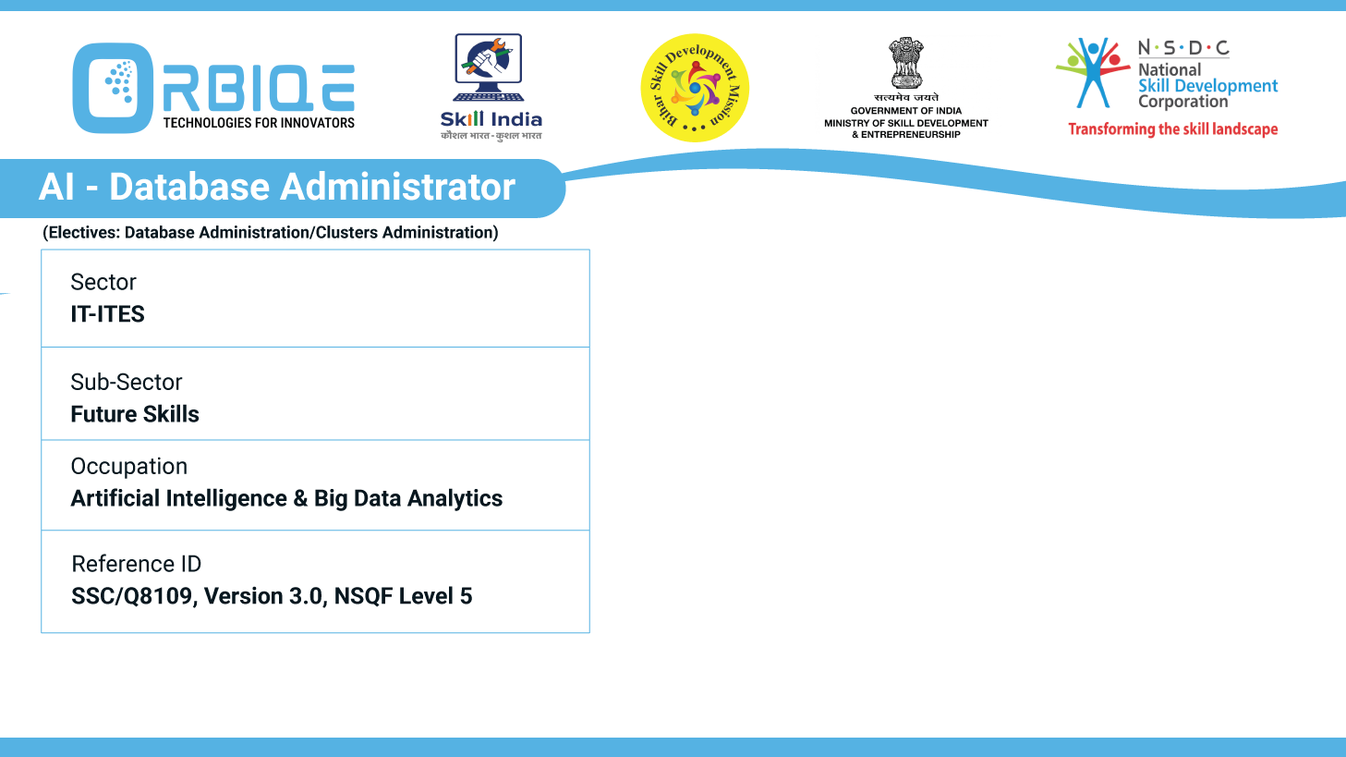
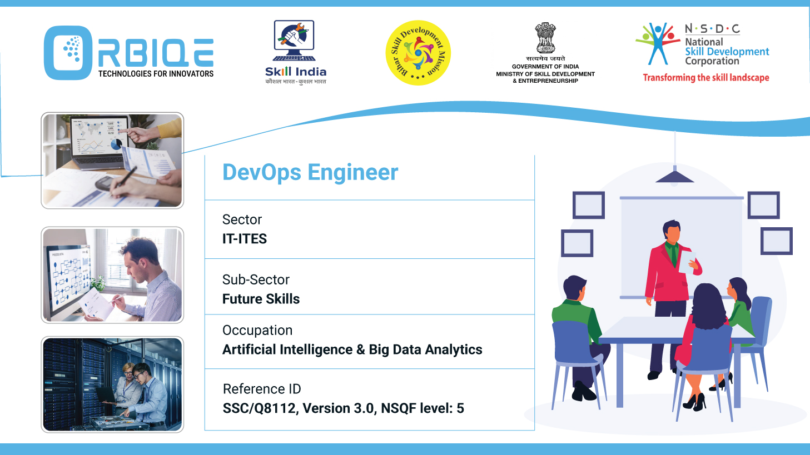
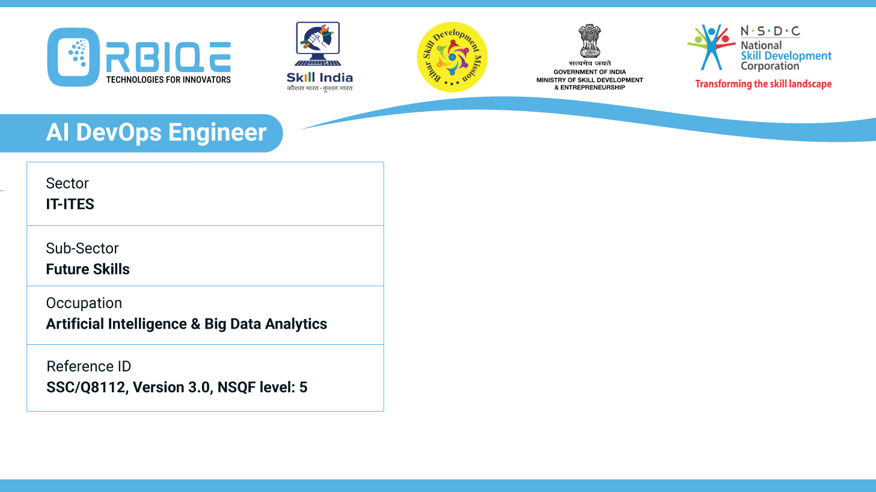
Name- Krishna Kant Dubey

Slide 2

Database Constraints: Unveiling the Limitations of SQL and NoSQL

Slide 3
Agenda
Describe the limitations of SQL and NoSQL databases, understanding the constraints and challenges associated with each database type in the

Slide 4
limitations of SQL and NoSQL databases
Limitations of SQL Databases (Relational)
Limitations of NoSQL Databases (Non-Relational)

Slide 5
Limitations of SQL Databases (Relational)
Structural Rigidity
Fixed Schema: Changes to the schema (e.g., adding columns) can be complex and disruptive.
Less Flexible for Unstructured Data: Not ideal for storing documents, images, or nested data.
Scalability Challenges
Vertical Scaling: Typically scale by upgrading hardware, which can be costly.
Limited Horizontal Scaling: Sharding and replication are possible but complex to implement.

Slide 6
Limitations of SQL Databases (Relational)
Performance Bottlenecks
Joins and Complex Queries: Can slow down performance with large datasets.
Write-Heavy Workloads: Not optimized for high-speed, concurrent writes.
Complexity in Distributed Systems
Replication and Failover: Requires careful configuration to maintain consistency and availability.
Latency in Global Deployments: ACID compliance can introduce latency across distributed nodes.

Slide 7
Limitations of NoSQL Databases (Non-Relational)
Weaker Consistency Guarantees
Eventual Consistency: Many NoSQL systems sacrifice immediate consistency for availability and partition tolerance (CAP theorem).
Data Conflicts: Can arise in distributed systems without strong consistency controls.
Query Limitations
Limited Join Support: Most NoSQL databases don’t support joins, making complex queries harder.
Custom Query Languages: Lack of standardization across NoSQL systems (e.g., MongoDB uses BSON queries).

Slide 8
Limitations of NoSQL Databases (Non-Relational)
Schema-less Pitfalls
Data Integrity Risks: Without enforced schemas, inconsistent or malformed data can creep in.
Validation Overhead: Developers must manually enforce data rules.
Operational Complexity
Backup and Restore: Can be more complex than traditional RDBMS.
Monitoring and Debugging: Tools may be less mature or standardized.
Security and Transactions
Limited ACID Transactions: Some NoSQL systems offer only partial transaction support.
Granular Access Control: May lack fine-grained security features found in mature RDBMS.

Slide 9
Thank You

